Slide 1


Department of Computer Science and Engineering
DEMENTIA PREDICTION USING SUPERVISED MACHINE LEARNING
DEVANATHAN A [211419104054]
DHARNISELVAN H [211419104061]
ARAVIND S [211419104015]
BATCH:E19
GUIDE:
Mr.THYAGARAJAN.C M.E.,(Ph.D.)
COORDINATOR:
Dr.N.PUGHAZENDI M.E., Ph.D.

Slide 2
Introduction
Dementia is a medical disorder in which the blood arteries in the brain are ruptured, causing damage to the brain. When the supply of blood and other nutrients to the brain is interrupted, symptoms might develop. According to the World Health Organization (WHO), Dementia is the greatest cause of death and disability globally.
Early recognition of the various warning signs of a Dementia can help to reduce the severity of the Dementia. Different machine learning (ML) models have been developed to predict the likelihood of a Dementia occurring in the brain.
Additionally, to compare and discuss the performance of various machine learning algorithms from the given hospital dataset with an evaluation classification report, identify the confusion matrix and to categorizing data from priority and the result shows that the effectiveness of the proposed machine learning algorithm technique can be compared with the best accuracy with precision, Recall and F1 Score.

Slide 3
Objective of the Project
"Dementia Prediction using Supervised Machine Learning" is to develop a model that can accurately predict the onset of dementia in individuals using supervised machine learning techniques. The model will be trained on a dataset containing various features such as age, gender, cognitive test scores, and other relevant health information.
The primary goal of this project is to create a reliable and accurate prediction model that can assist healthcare professionals in identifying individuals who are at risk of developing dementia, enabling them to provide targeted interventions and support to delay or prevent the onset of the disease.
Additionally, the project aims to contribute to the field of machine learning and healthcare by exploring the potential of predictive models in identifying and treating cognitive impairments such as dementia.

Slide 4
Literature Survey
S.NO | PAPER TITLE | OBJECTIVE | AUTHOR NAME
1. | Brain Dementia Prediction Using Machine Learning Approach | The research has taken numerous factors and utilized ML calculations like Logistic Regression, Decision Tree Classification, Random Forest Classification, KNN, and SVM for accurate prediction | DR. AMOL K. KADAM , PRIYANKA AGARWAL

Slide 5
S.NO | PAPER TITLE | OBJECTIVE | AUTHOR NAME
2. | Machine Learning for Brain Dementia: A Review | Besides, maximum studies are found in Dementia diagnosis although number for Dementia treatment is least thus, it identifies a research gap for further investigation. Similarly, CT images are a frequently used dataset in Dementia. | Manisha Sanjay Sirsat, Eduardo Ferme , and Joana Camara
3. | Towards Dementia prediction using electronic health records | They designed and incorporated regularization terms into the standard cross-entropy loss function. These terms penalized false positive and false negative predictions. We evaluated the performance of our trained models using Receiver Operating Characteristic. | Douglas Teoh

Slide 6
Problem Statement
Dementia is a progressive neurological disorder that impairs cognitive functions such as memory, communication, and reasoning. Early detection and diagnosis of dementia are critical for providing effective treatment and improving patient outcomes.
The use of supervised machine learning algorithms to predict dementia risk based on clinical and demographic data has shown promising results. However, the development of accurate and reliable prediction models requires further investigation and optimization.
Therefore, this project aims to explore the feasibility of using supervised machine learning to predict dementia risk and develop an accurate prediction model that can aid in the early detection and management of dementia.

Slide 7
Proposed System
The proposed method is to build a machine learning model for the classification of brain Dementia. The process carries from data collection where past data related to brain Dementia are collected.
A brain Dementia if found before proper treatment can save lives. Machine learning is now applied and mostly used in health care where it reduces the manual effort and a better model makes error less which leads to saving the life.
The data analysis is done on the dataset proper variable identification is done that is both the dependent variables and independent variables are found. The proper machine learning algorithms are applied to the dataset where the pattern of data is learned. After applying different algorithms a better algorithm is used for the prediction of the outcome.

Slide 8
Software / Hardware used
OPERATING SYSTEM : WINDOWS 10 (64 BIT)
RAM : 4GB AND ABOVE
SOFTWARE : PYTHON AND ANACONDA
TOOLS : JUPYTER NOTE BOOK
PROCESSOR : I3 AND ABOVE
HARD DISK : 500GB AND ABOVE

Slide 9
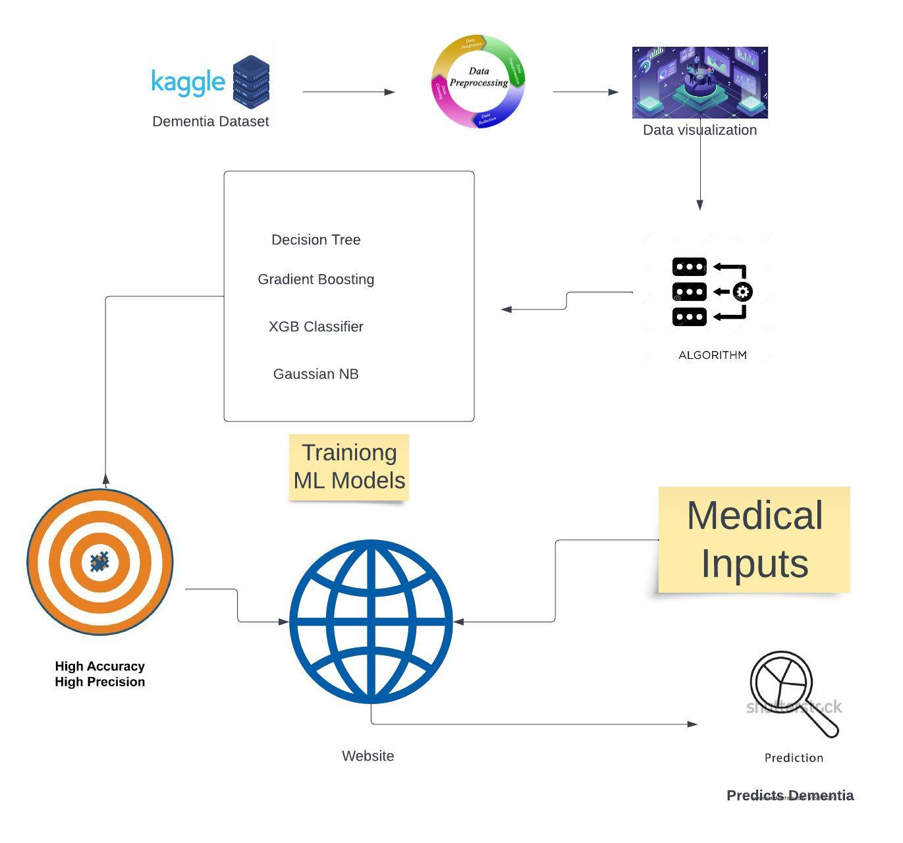
Architecture / Methodology used

Slide 10
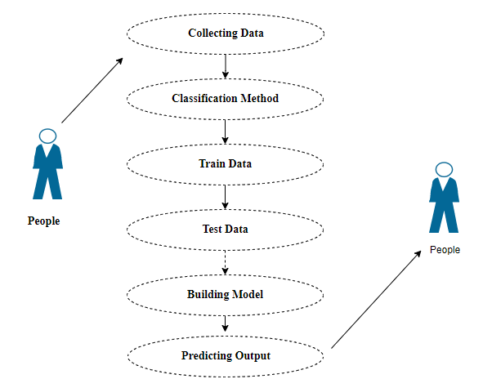
System Design-Use case Diagram

Slide 11
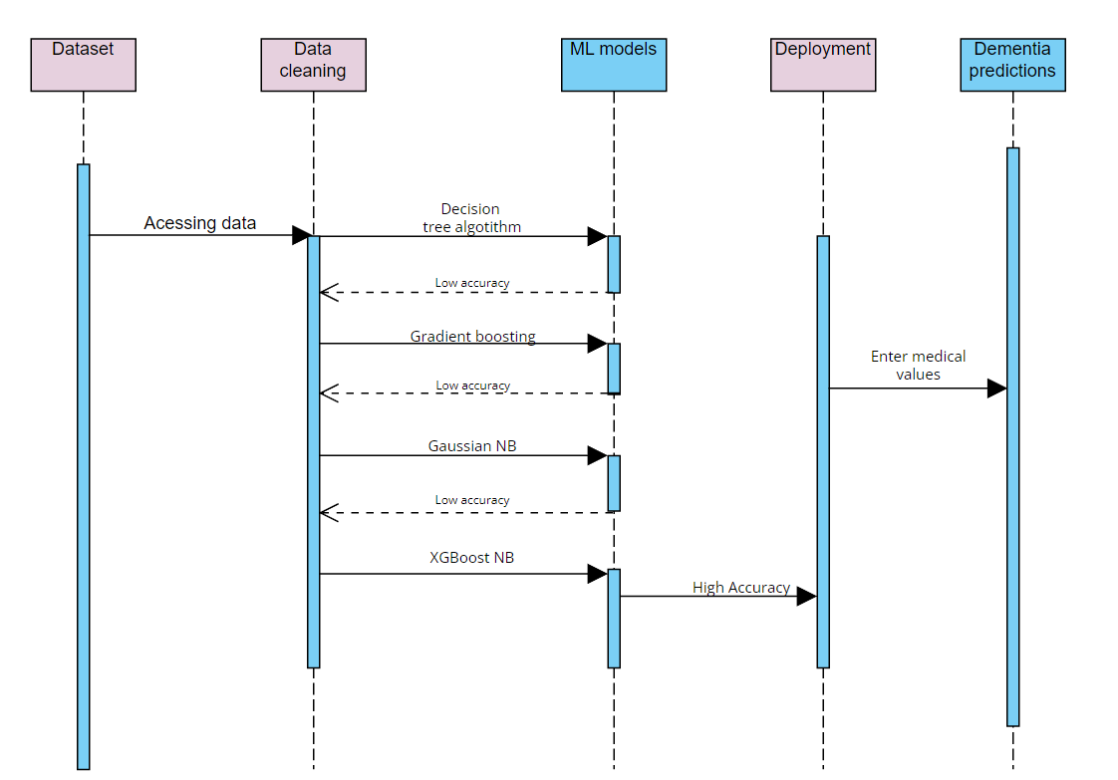
System Design-Sequence diagram

Slide 12
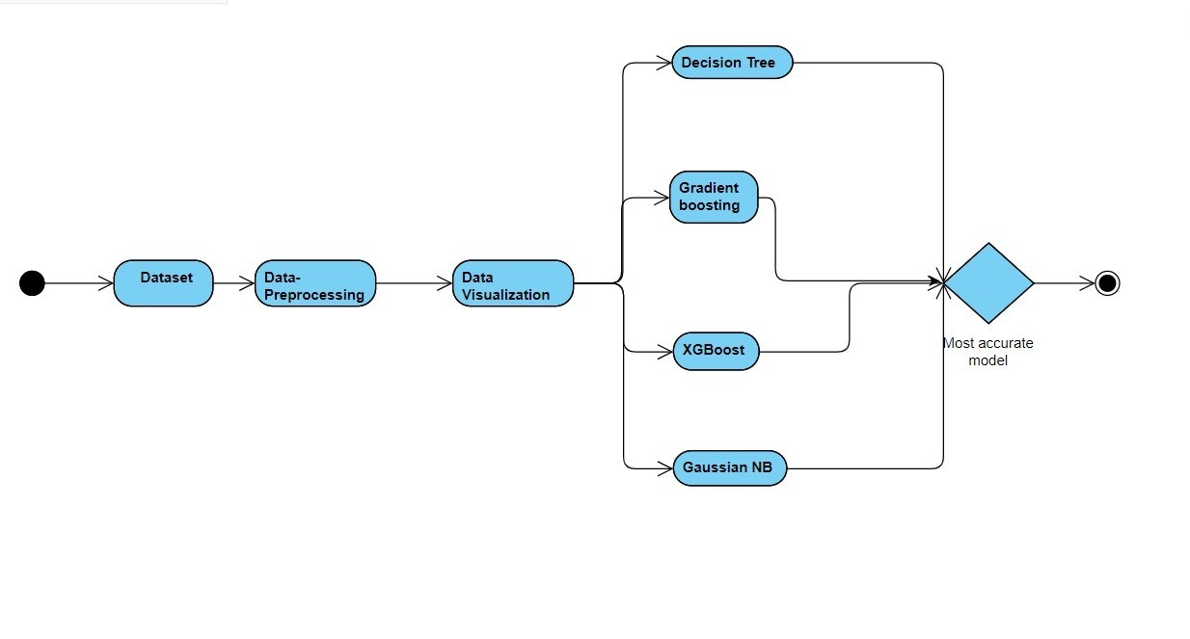
System Design – Activity diagram

Slide 13
Module Description
The system is made up of 7 Modules
Data Preprocessing
Data visualizing
4 Different Trained ML models( Module 3-6)
Deployment

Slide 14
Module Description
MODULE 1:
Data Pre-processing Module: Loading the supplied dataset and importing library packages to investigate variable’s identity by data type and shape and to assess duplicated and values that are missing. The provided dataset must be renamed, columns must be deleted, and other data cleaning and preparation steps must be completed in order to analyze the uni-variate, bi-variate, and multi-variate processes depending on the dataset, several procedures and techniques will be used to clean the data. To boost the worth of datasets for analysis and decision-making, data cleaning aims to find and remove mistakes and anomalies.

Slide 15
Module Description
MODULE 2:
Data Visualization Module:
Data visualizations can be used to convey and demonstrate important relationships using plots and graphs that are more visceral and attractive to stakeholders than measures of association or significance.
Unless data is graphically represented, such as via charts and graphs, it might not always make sense. Fast visualization of samples of data and other objects is valuable in both statistical applications and applied machine learning.

Slide 16
Module Description
ML Models(3-6 modules)
To ensure the system produces the best results and is as accurate as possible, 4 distinct machine learning algorithms have been used in its implementation.
Decision tree
Gradient Boosting Classifier
XGB classifier
Gaussian NB
After training all the model a live website is created which predicts the possibilities of dementia. For this the machine learning model which gave high accuracy is used by accessing its as a model file in our python program. The tools used in this deployment model are

Slide 17
Module Description
Deployment module:
The last stage will be to use our web application to deliver exact and accurate results to the user, allowing them to proceed as needed in accordance with the results.
The system will finally produce the desired result after the approach, modules, algorithms, and codes have been implemented. The homepage will assist users in entering the information needed for the Dementia prediction system, and the GUI portion is designed to be user-friendly for regular people. The system has been developed utilizing four distinct ML algorithms, as specified in the Implementation, to obtain the best accuracy while using the dataset.

Slide 18
Testing /Performance Evaluation / Results
PRODUCT: Give required inputs for prediction
USECASE: Values
TEST CASE ID | TESTCASE / ACTION TO BE PERFORMED | EXPECTED RESULT | ACTUAL RESULT | PASS/ FAIL
1 | Give Input Values | Dementia is demented | Dementia is demented | PASS
2 | Give Input Values | Dementia is Non-demented | Dementia is Non-demented | PASS
3 | Give Input Values | Dementia is converted | Dementia is converted | PASS

Slide 19
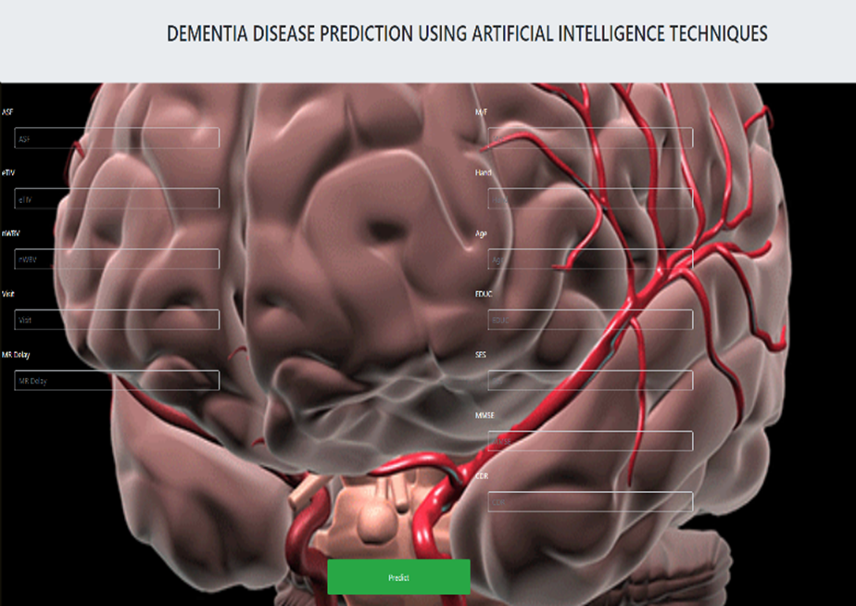
Screen Shots

Slide 20
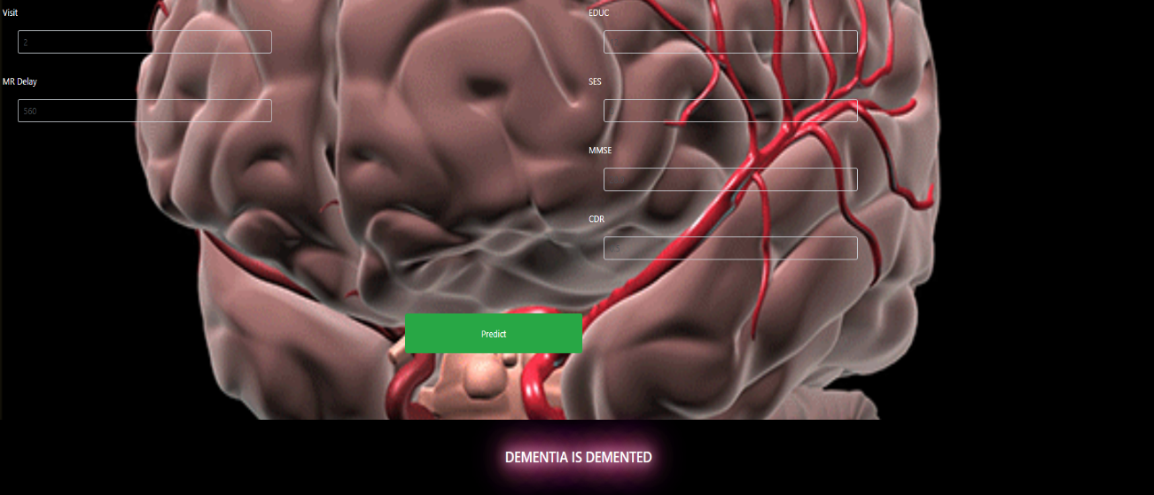
Screen Shots

Slide 21
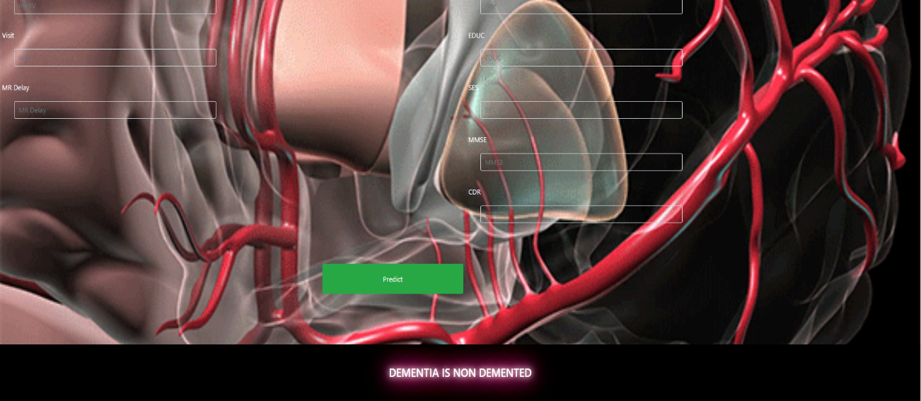
Screen Shots

Slide 22
Conclusion
After conducting a literature review, we learned about the various benefits and drawbacks of various research papers and proposed a system that predicts Dementia in a cost-effective and efficient manner by requiring few inputs from the user and predicting accurate results using trained Machine Learning algorithms. Thus, the Dementia Prediction was constructed employing four Machine Learning algorithms with the greatest accuracy of 94.36.
Consequently, the system is intended to offer a straightforward yet effective Design of user interfaces with a sympathetic viewpoint towards its clients and patients. The system has room for growth in the future, which can lead to greater results and improved customer service. This will assist the user in saving precious time and empower them to take appropriate action based on the results provided.

Slide 23
Future Enhancement
In order to improve the performance of a dementia prediction model, you could collect more data from a larger and more diverse population, including individuals from different ethnic groups, socioeconomic backgrounds, and age ranges.
For healthcare providers, patients, and caregivers to effectively use a dementia prediction model, it needs to have a user-friendly interface.
Integrating the dementia prediction model with electronic health records could allow healthcare providers to automatically screen patients for dementia risk during routine check-ups and provide targeted interventions when necessary.
Adding genetic data to a machine learning model could improve its accuracy and help identify individuals who are at higher risk for developing the disease.

Slide 24
Reference Paper/ URL
https://ieeexplore.ieee.org/document/8759397

Slide 25
REFERENCES
[1] Hongming Li , Yong Fan ; Alzheimer’s Disease Neuroimaging Initiative, “EARLY PREDICTION OF ALZHEIMER'S DISEASE DEMENTIA BASED ON BASELINE HIPPOCAMPAL MRI AND 1-YEAR FOLLOW-UP COGNITIVE MEASURES USING DEEP RECURRENT NEURAL NETWORKS”, Proc IEEE Int Symp Biomed Imaging, 2019,Apr;2019:368-371,doi:10.1109/ISBI.2019.8759397. Epub 2019 Jul 11.
[2] Priyanka Agarwal ; Mudit Khandelwal ; Nishtha ; Dr. Amol K. Kadam, “Brain Stroke Prediction using Machine Learning Approach”, 2022, Published In: Iconic Research And Engineering Journals , Paper ID: 1703646.
[3] P. Govindarajan, R. K. Soundarapandian, A. H. Gandomi, R. Patan, P. Jayaraman, and R. Manikandan, stroke disease classification using machine learning algorithms,” Neural Computing and Applications in 2019.

Slide 26
REFERENCES
[4] Dharvi Soni; Safvan Vahora , “A Review On Alzheimer Disease Prediction Methodology” 2022, doi: 10.1109/ICAIS53314.2022.9743137.[6] Xiaoling Wang “A Video-based Traffic Violation Detection System”, https://www.researchgate.net/publication/271545712, December 2013 DOI: 10.1109/MEC.2013.6885246
[5] Dementia Prediction w/ Tree-based Models. Kaggle.com, 2018,https://www.kaggle.com/code/ruslankl/dementia-prediction-w-tree-based-models/report

Slide 27
THANK YOU

